Slide 1

DESIGN OF Compact AND wearable Bio-Medical ANTENNA FOR BREAST CANCER DETECTION
Presented By
1.KESHAVARDHINI S V (421219121016)
2.POOJAJOSEPHINE A (421219121022)
3.PREETHI J (421219121025)
Guided By
Dr.T.SANGEETHA,
ASSISTANT PROFESSOR, DEPARTMENT OF BIOMEDICAL ENGINEERING.

Slide 2
OUTLINE
Abstract
Motivation
Objective
Introduction
Literature Review
Software And Hardware Requirements
Proposed Work
Future Work
Advantages
Reference

Slide 3
Abstract
A broad-band, conformal, highly efficient antenna for bio-medical and 5G applications is presented in this communication. Flexibility of an antenna is achieved by printing radiating elements on 0.6-mm-thick jeans fabric. Wide-band operation of the proposed antenna is obtained by making a square slot in the ground plane along with a circular radiator that is printed above the substrate. To validate the real-time performance of the antenna, conformability analysis has been made, thereby assessing the robustness of the proposed system. The antenna achieves overall efficiency up to 90 % over the operating spectrum with a substantial gain of around 3.35dB. The antenna exhibits a minimum Specific Absorption Rate lower than 0.7 W/Kg for both 1 g and 10 g human tissues. A detailed state-of-the-art comparison has been provided to demonstrate how it differs from other antennas in the literature.

Slide 4
MOTIVATION
Wearable antennas are designed to function while being worn
These antennas are commonly used in wearable wireless communication and bio-medical RF systems
Wearable antennas are used within the context of Wireless Body Area Networks (WBAN).
In a WBAN, antenna is the key component that supports wireless communication, which include in-body communication, on-body communication and off-body communication
A WBAN connects sensors, actuators and IoT nodes on human body, or on cloths or under the skin, establishing a wireless communication channel
Wearable antennas can be employed on people of all ages, athletes and patients for a continuous monitoring of vital signs, oxygen level (Oximetry) and stress level, among others.

Slide 5
OBJECTIVE
To design a low-cost flexible antenna for bio-medical applications with slotted ground is presented here.
To propose the ultra-wideband micro strip antenna for breast cancer detection.
To design antenna to meet the UWB specifications.
To study the performance of the antenna with and without tumor.
To compare the current density of the breast with tumor and breast without tumor.

Slide 6
INTRODUCTION Wearable Antennas
The demand for wearable electronics and related technologies have grown tremendously in recent years
Some of the key developments that accelerated this growth are miniaturization of wireless devices, advent of high-speed wireless networks, availability of ultra-compact, low-power SoCs and ever-evolving battery technologies
Wearable electronics find numerous applications these days, and most of these applications use different types of antennas to sense, fetch, and exchange data wirelessly to and from a host device or an IoT gateway

Slide 7
INTRODUCTION Wearable Antennas
Wearable antennas are designed to function while being worn
These antennas are commonly used in wearable wireless communication and bio-medical RF systems
Wearable antennas are used within the context of Wireless Body Area Networks (WBAN).
In a WBAN, antenna is the key component that supports wireless communication, which include in-body communication, on-body communication and off-body communication

Slide 8
INTRODUCTION Wearable Antennas
A WBAN connects sensors, actuators and IoT nodes on human body, or on cloths or under the skin, establishing a wireless communication channel
Wearable antennas can be employed on people of all ages, athletes and patients for a continuous monitoring of vital signs, oxygen level (Oximetry) and stress level, among others.

Slide 9
Literature Review Literature Survey
TITLE | AUTHOR | YEAR | INFERENCE
Low-Cost Antenna –Array-Based Metamaterials for Non-Invasive Early-Stage Breast Tumor Detection in the Human Body | Yadgar I,Abdulkarim& Musa N Hamza | 2022 | Propose- developed low-cost microstrip patch antenna suitable for microwave imaging(MWI) application within the wideband frequency range.
Miniaturized inward fractal antenna for Breast Cancer Detection | Maria N.Moussa and Mervat A.Madi | 2021 | Efficient early cancer detection techniques in order to improve the survival rates as much as possible. Along this line and using EM detection approach, a miniaturized inward fractal antenna of size 10x10mm2.
Design of a microstrip antenna for Breast Cancer Detection | Hector Kaschel And Cristian Ahumada | 2021 | It is also a low cost microstrip antenna and it is high in efficiency regarding to breast cancer deduction it achieves the wide bandwidth (BW) of 2.26-233.37 GHz.

Slide 10
Literature Review contd....
TITLE | AUTHOR | YEAR | INFERENCE
Miniaturized Spiral UWB Transparent Wearable Flexible Antenna for Breast Cancer Detection | Tale Saeidi and Sameer Alani | 2020 | Proposed antenna achieves the wide bandwidth(BW) of 3.26-23.27 GHz, more than 65% radiation efficiency for most of the working BW, and maximum radiation efficiency of 90% at 15 GHz.
Breast Cancer Detection using adaptable textile antenna design | Dhamodharan Srinivasan & Mohanbabu Gopalakrishnan | 2019 | Implementation a novel flexible antenna for detection of early breast cancer, with and without tumour application.
Design and experimental investigation of a compact circularly polarized integrated filtering antenna for Wearable biotelemetric device | Jiang, Z.H et.al | 2017 | Here a new research area called the visual data mining is being developed endeavouring to use the number crunching power of computers to prepare data for visualization.

Slide 11
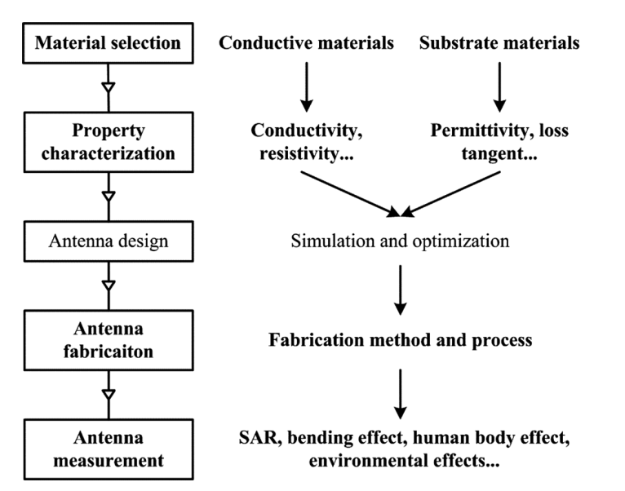
METHODOLOGY

Slide 12
SOFTWARE AND HARDWARE REQUIREMENTS
SOFTWARE | HARDWARE COMPONENTS
HFSS – HIGH FREQUENCY SIMULATION SOFTWARE | ANTENNA TRANSMITTER
- | ANTENNA RECEIVER
- | ANTENNA TUNER

Slide 13
Proposed Work
This work investigated the feasibility of developing and producing a highly efficient and totally flexible wearable microstrip patch antenna with a centre operating frequency of 4.5 GHz.
The goal was to get closer to actual wearability. For conducting portions, two kinds of conducting materials have been employed: traditional metal plane and woven electro-textile material, while a non-conducting denim fabric has been used as the antenna substrate material. Using two distinct approaches, the dielectric constant 4.4 and the loss tangent tan = 0.02 were determined for the denim substrate.
In addition, the suggested wearable antenna may be connected to the human body; hence, the specific absorption ratio (SAR) must be computed. Finally, the suggested design is modelled using CST simulator version 2016 and produced using folded copper.

Slide 14
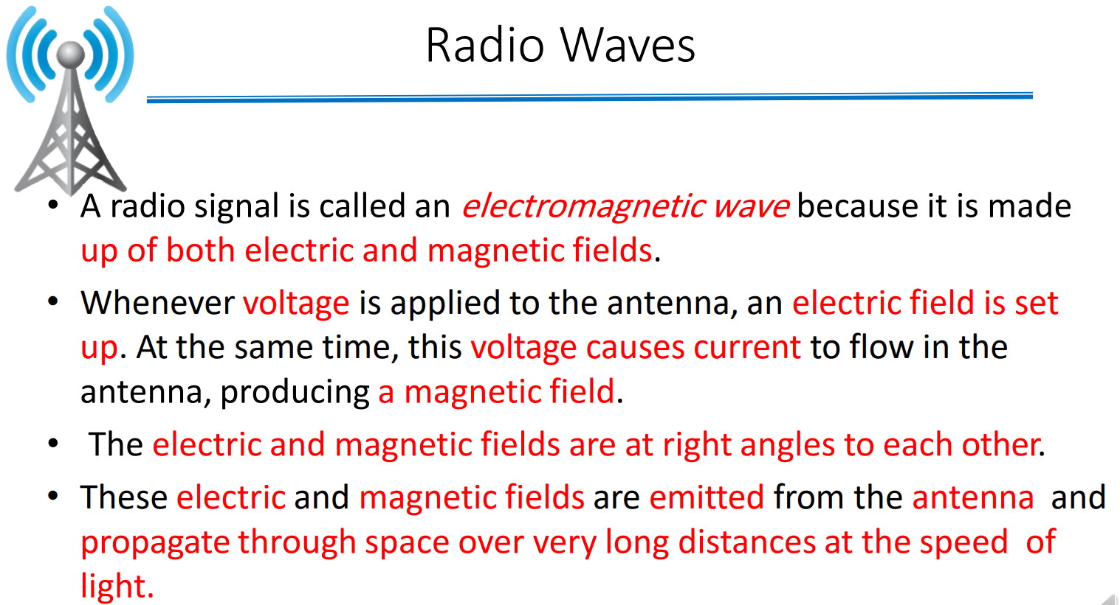

Slide 15
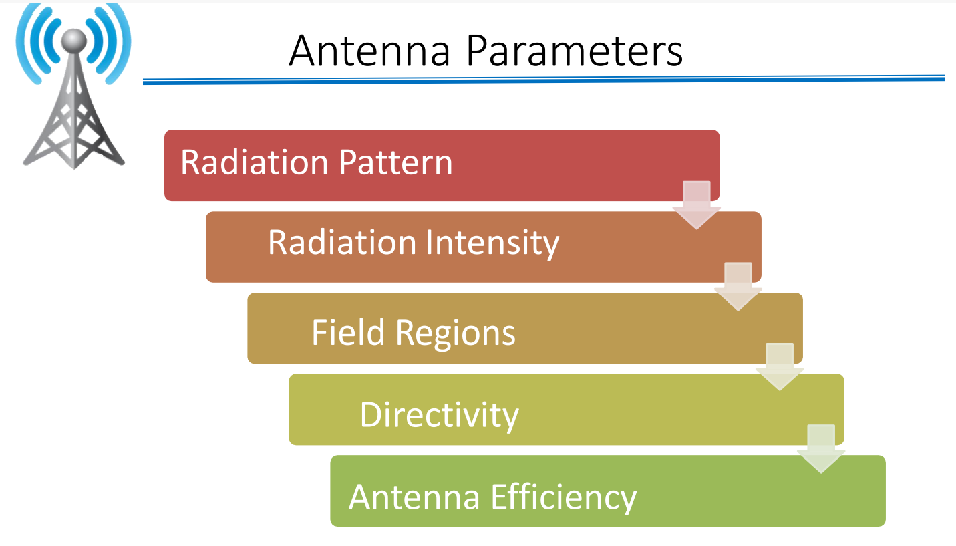

Slide 16
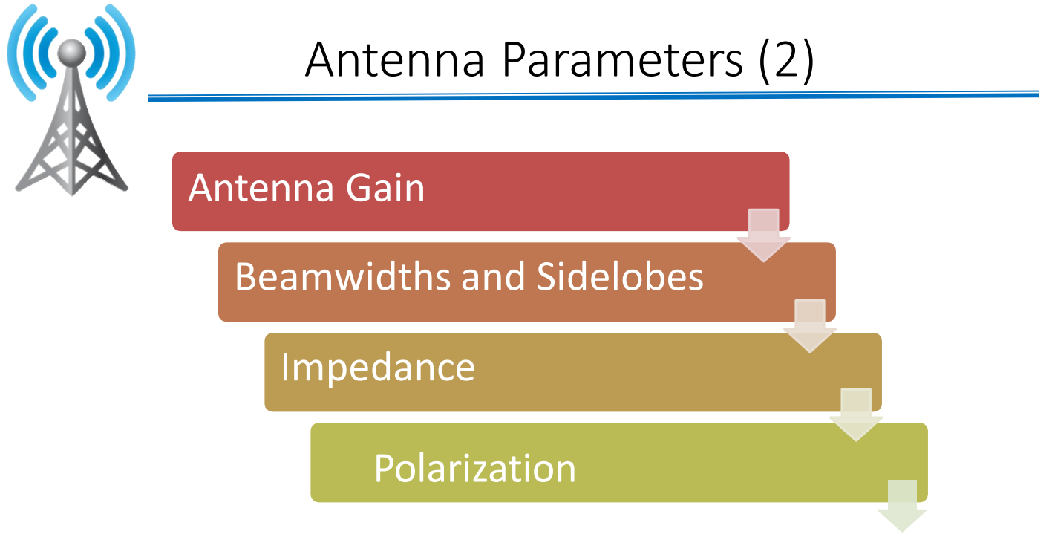

Slide 17
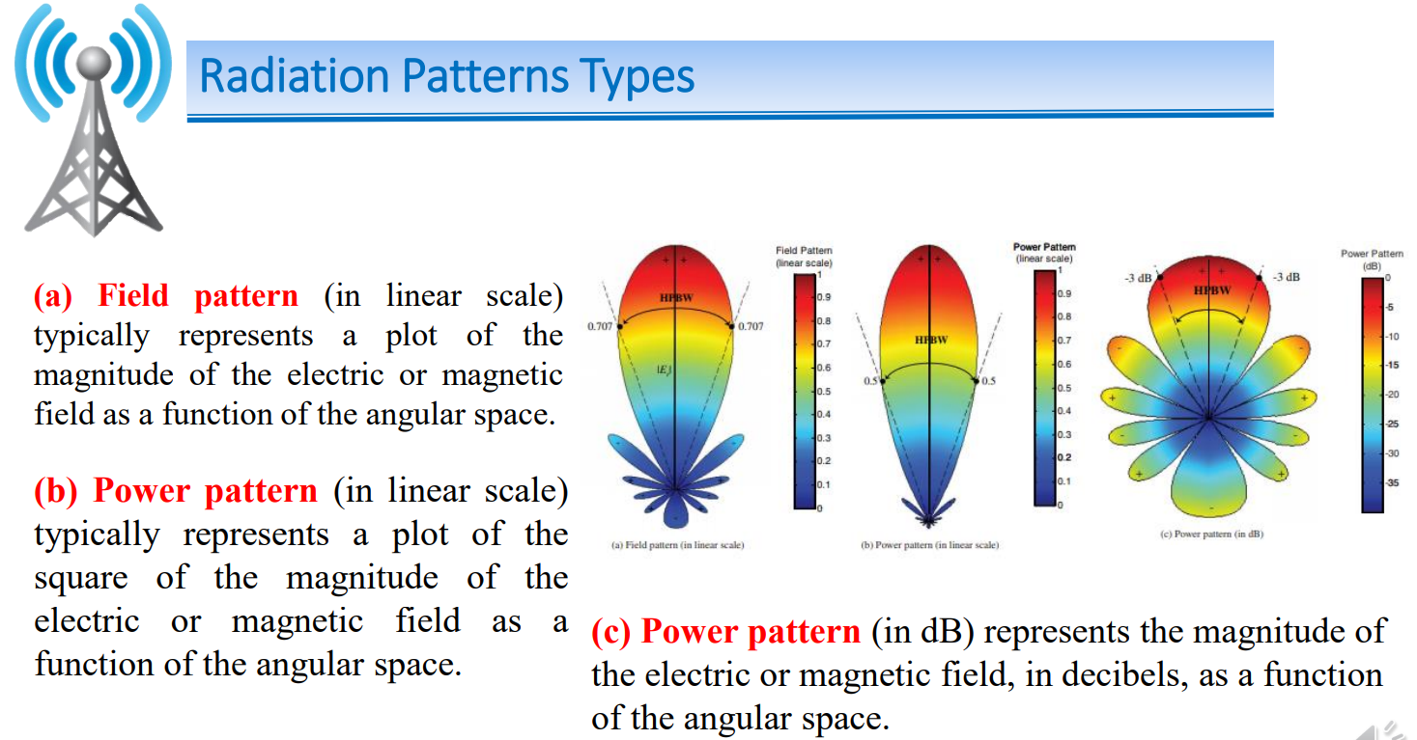

Slide 18
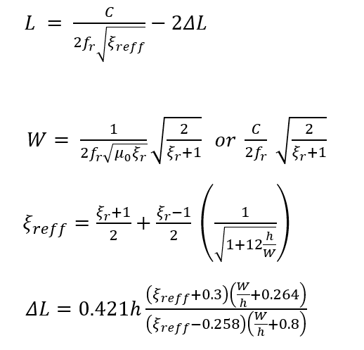
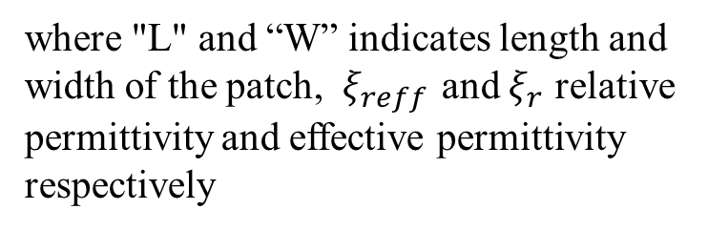
Methodology-Design Equations
where "L" and “W” indicates length and width of the patch, $ξ_{reff }$and $ξ_{r}$ relative permittivity and effective permittivity respectively

Slide 19
FUTURE WORK
From prediction of breast cancer detection can share the information to medical sector using IOT.
To speedup treatment .
Using machine learning algorithm can improve accuracy.

Slide 20
ADVANTAGES
Low specific absorption rate value which makes the system safe, portable and easily wearable.
The proposed system will provide a user friendly in-house, pain free, low cost scanning system for women who required continuous examination of their breast.

Slide 21
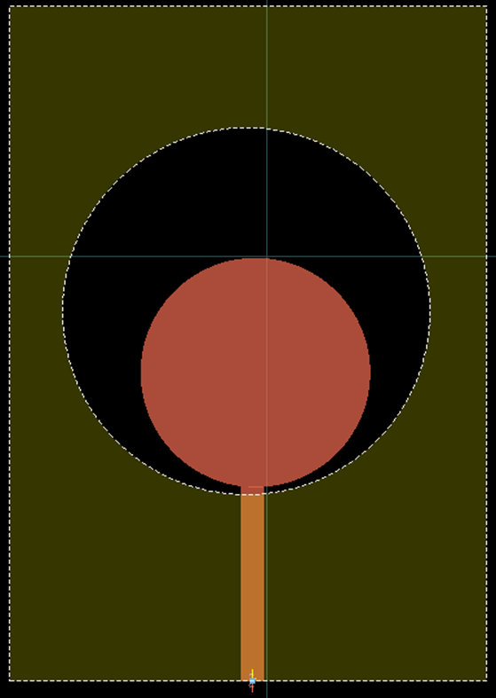
Antenna Design and Results
The antenna is designed on the substrate of size 58.58 x 60 mm² with the thickness of 1.6 mm.

Slide 22
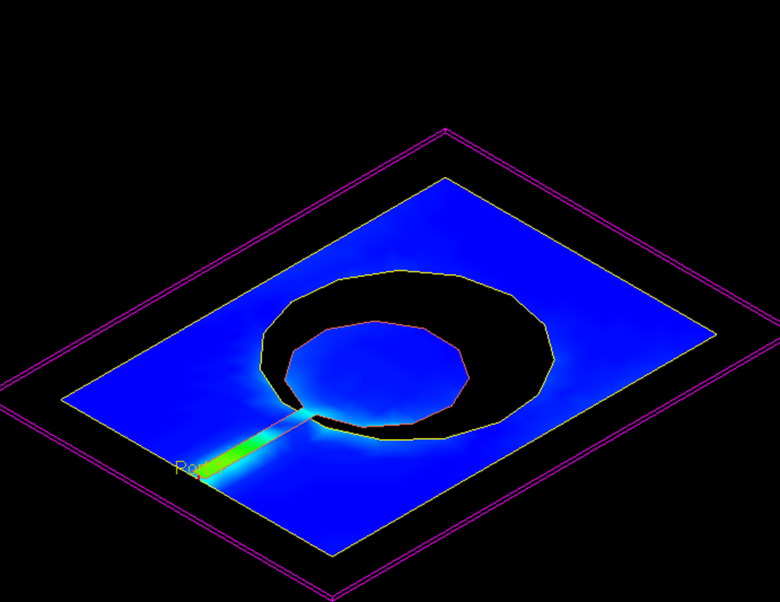
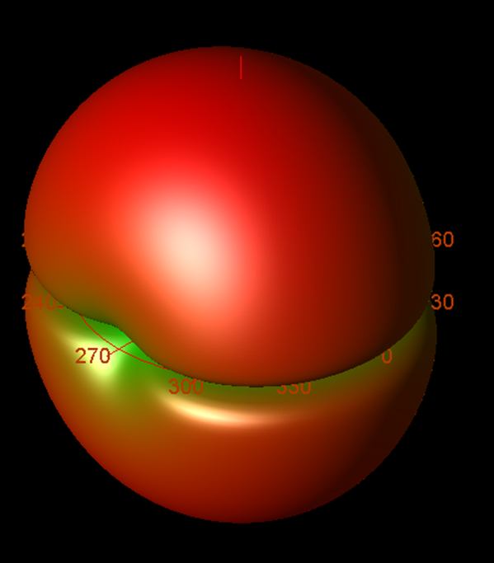
Antenna Design And Results
The surface current density of the proposed antenna at 4.5 GHz 3D radiation pattern shown in Figures

Slide 23
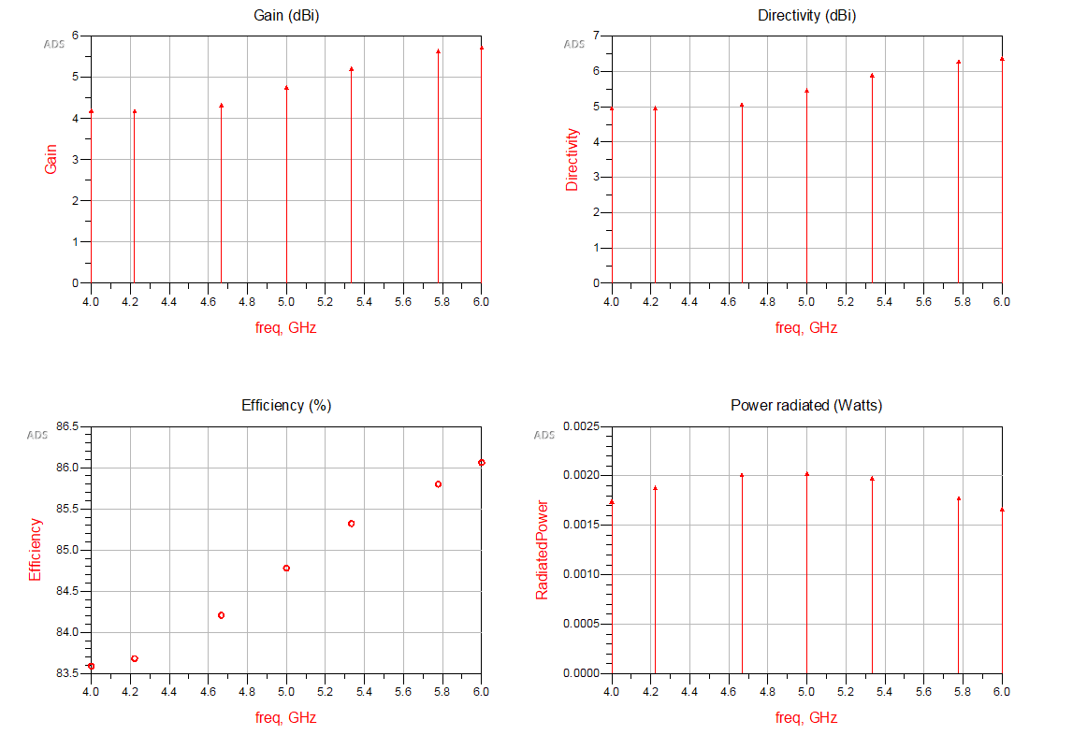
Antenna Design and Results
The gain, Directivity, Efficiency ,radiated power and radiation patterns of the proposed antenna is shown in Figures

Slide 24
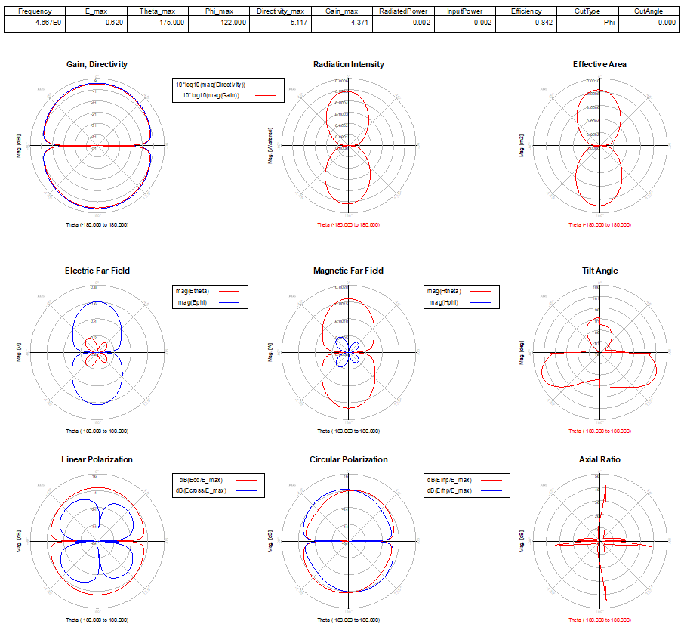

Slide 25
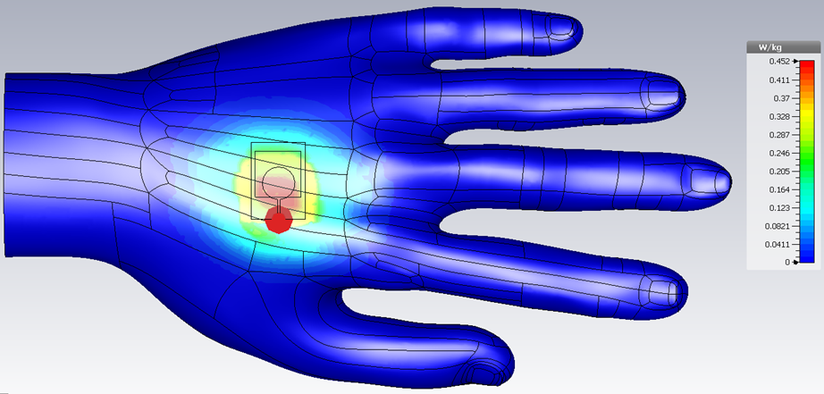
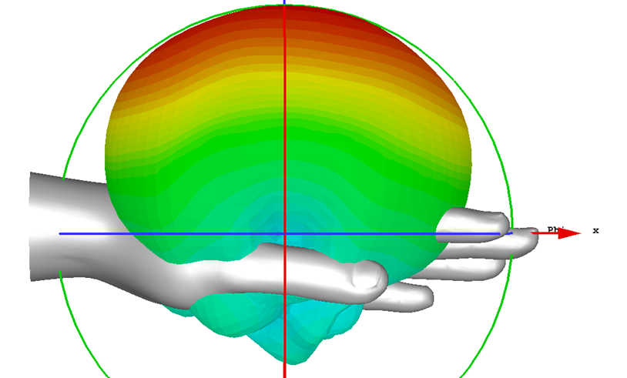
Antenna Design and Results
Placement analysis are illustrated

Slide 26
BUDGET
S.NO | COMPONENTS | RATE (INR)
1. | ANTENNA FABRICATION | 6,000
2. | CALCULATION OF S-PARAMETER | 3,000
3. | REAL TIME TESTING | 1,000
 | TOTAL | 10,000

Slide 27
References :
Jiang, Z. H., M. D. Gregory, and D. H. Werner, “Design and experimental investigation of a compact circularly polarized integrated filtering antenna for wearable biotelemetric devices,” IEEE Transactions on Biomedical Circuits and Systems, Vol. 10, No. 2, 328–338, Apr. 2016.
Jain, S.K., Baviskar, N., Golait, N., Jain, S., Design of Wearable Antenna for Various Applications. Antenna Test & Measurement Society (ATMS India18), pp. 2–6, 2018
Al-Ashwal, W.A.M., Ramli, N.K., Mohamud, S., Performance of ultra-wideband wearable antenna under severe environmental conditions and specific absorption rate (SAR) study at near distances. ARPN J. Eng. Appl. Sci., 10, 4, 1613–1622, 2014.
Langenhove, L. V., Smart Textiles for Medicine and Healthcare, CRC Press, Cambridge, England, 2007.
Park, S. and S. Jayaraman, “Wearable biomedical systems: Research to reality,” IEEE International Conference on Portable Information Devices, May 2007.
Sankaralingam, S. and B. Gupta, “Development of textile antennas for body wearable applications and investigations on their performance under bent conditions,” Progress In Electromagnetics Research B, Vol. 22, 53–71, 2010.
Kennedy, T. F., P. W. Fink, A. W. Chu, N. J. Champagne, G. Y. Lin, and M. A. Khayat, “Bodyworn e-textile antennas: The good, the low mass, and the conformal,” IEEE Transactions on Antennas and Propagation, Vol. 57, 910–918, 2009.
Ouyang, Y., E. Karayianni, and W. J. Chappell, “Effect of fabric patterns on electro-textile patch antennas,” IEEE Antennas and Propagation Society International Symposium, Vol. 2B, 246–249, 2005.
Abbasi, M. A. B., S. S. Nikolaou, M. A. Antoniades, M. N. Stevanovi´c, and P. Vryonides, “Compact EBG-backed planar monopole for BAN wearable applications,” IEEE Transactions on Antennas and Propagation, Vol. 65, No. 2, 453–463, Feb. 2017.
Lotfi, P., S. Soltani, and R. D. Murch, “Printed endfire beam-steerable pixel antenna,” IEEE Transactions on Antennas and Propagation, Vol. 65, No. 8, 3913–3923, Aug. 2017.

Slide 28
THANK YOU

